Slide 1
5th Semi Annual POSNA/SLAOTI/EPOS
(Tri Continental) Pediatric Orthopedic Surgery Symposium
Sao Paulo, Brazil
October 11-14, 2017
Technical Problems to Avoid in Performing Open Reduction of DDH
Perry L. Schoenecker, M.D.
St. Louis Shriners, St. Louis Children’s & Barnes Hospitals, Washington University School of Medicine, Department of Orthopaedic Surgery, St. Louis, Missouri, USA
No Conflicts, No Disclosure

Slide 2
5th Semi Annual POSNA/SLAOTI/EPOS
(Tri Continental) Pediatric Orthopedic Surgery Symposium
Sao Paulo, Brazil
October 11-14, 2017
Technical Problems to Avoid in Performing Open Reduction of DDH
Perry Schoenecker, MD
No Conflicts Or Disclosures Pertinent To Presentations

Slide 3
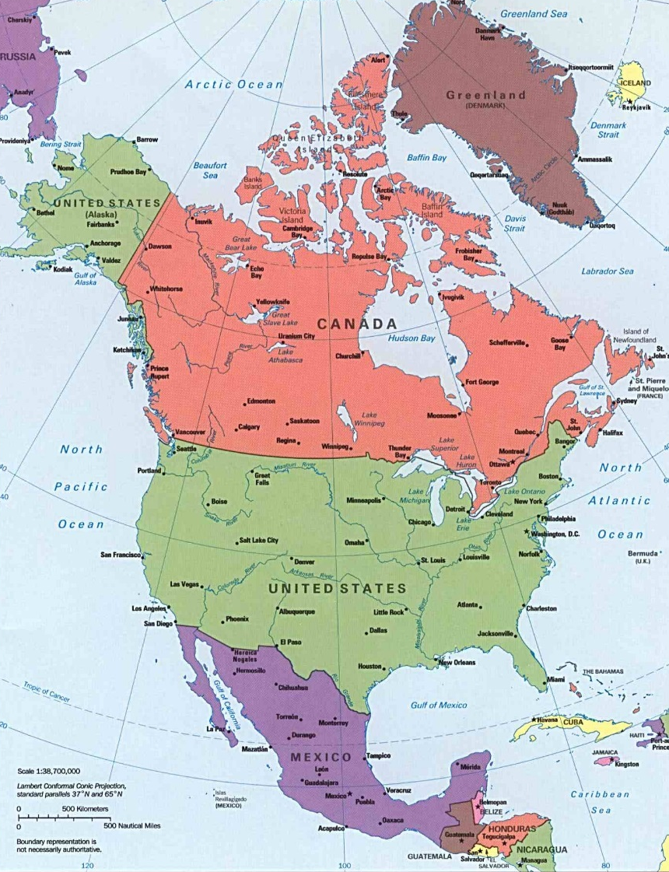

Slide 4
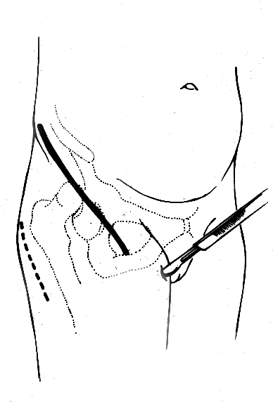
Anterior arthrotomy
Rectus tenotomy
Adductor tenotomy
Possible PFO
Tensor sartorius interval

Slide 5
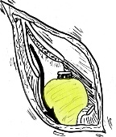
First obtain lateral exposure . . . Reflect abductors off capsule

Slide 6
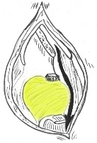
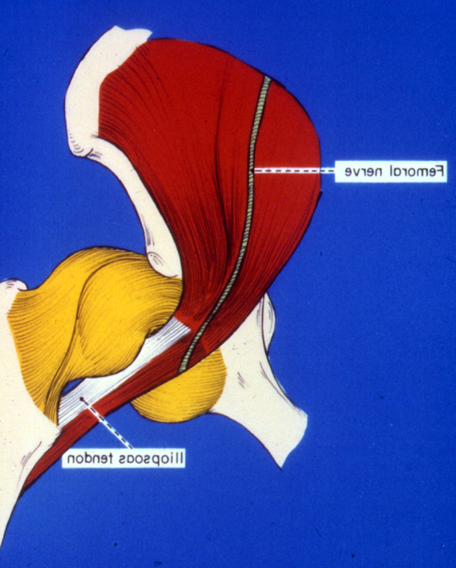
Then expose anterior & medial capsule
Femoral nerve
Iliopsoas tendon
Tight psoas

Slide 7
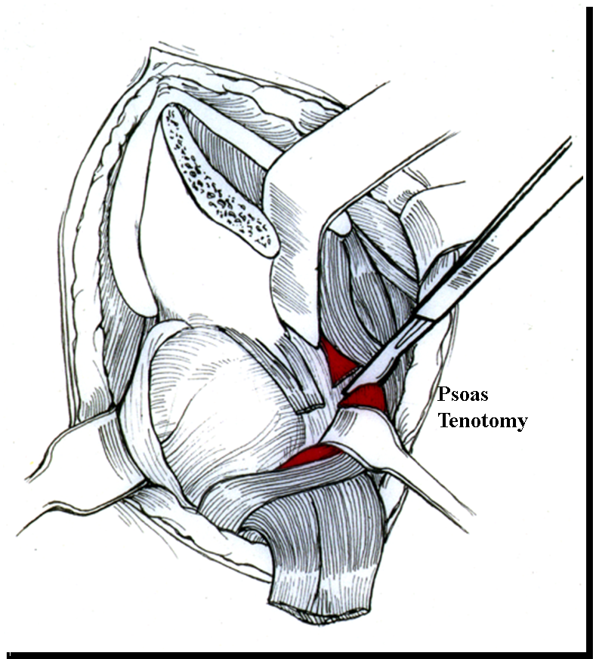
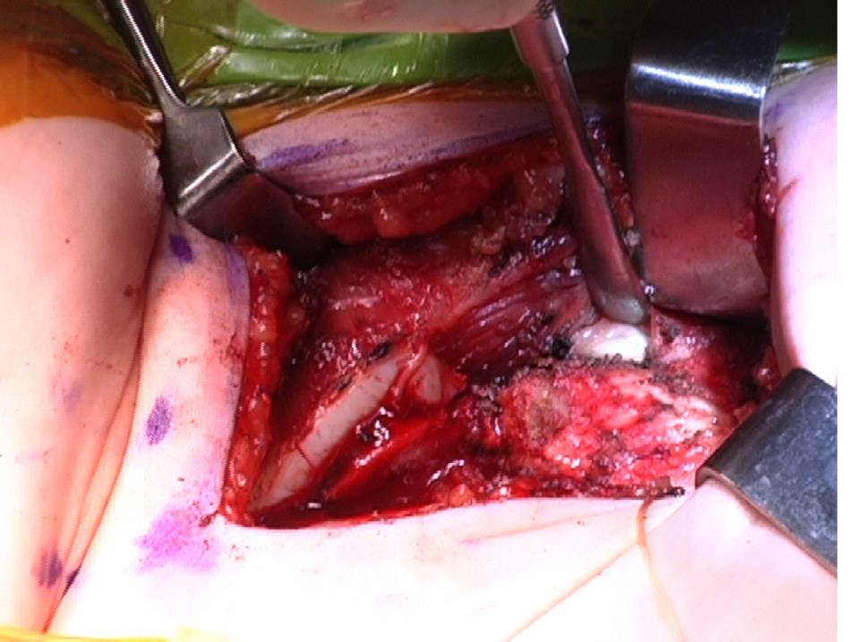

Slide 8
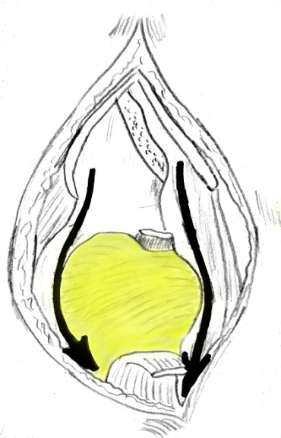
obtaining lateral, anterior & MEDIAL capsule is critical

Slide 9
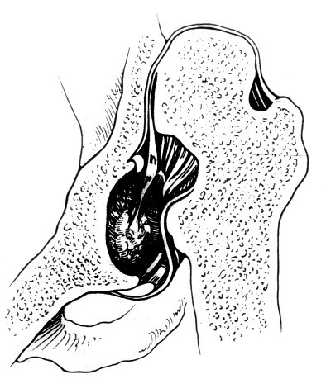
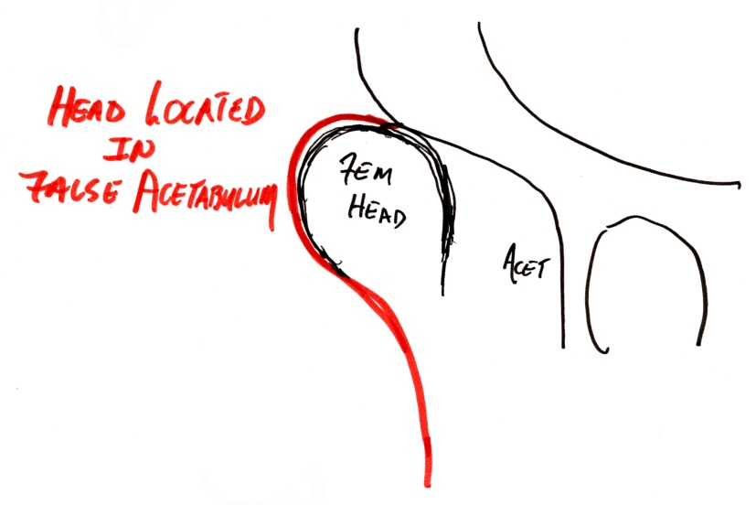
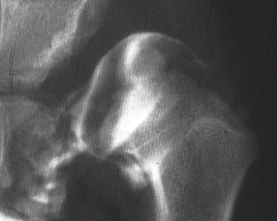
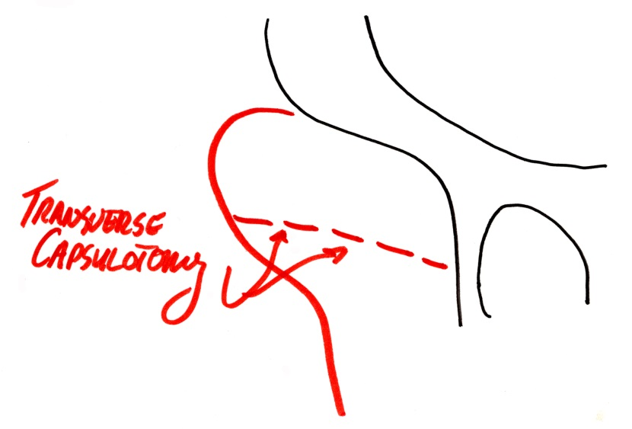
Deformed head
Arthrogram
Colin Moseley, et al

Slide 10
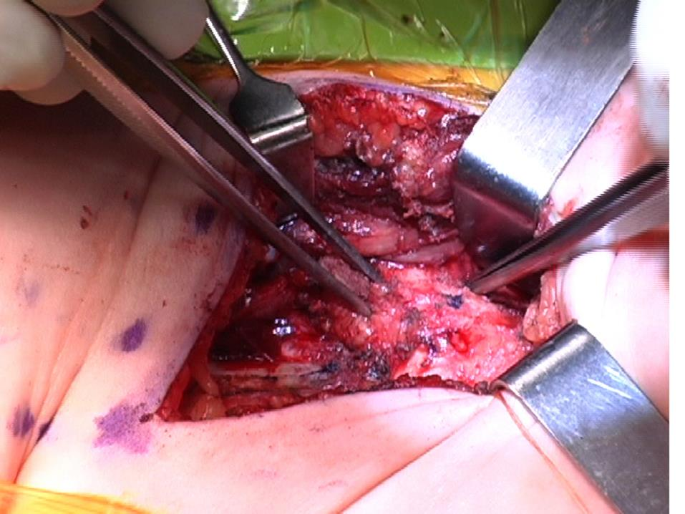

Slide 11
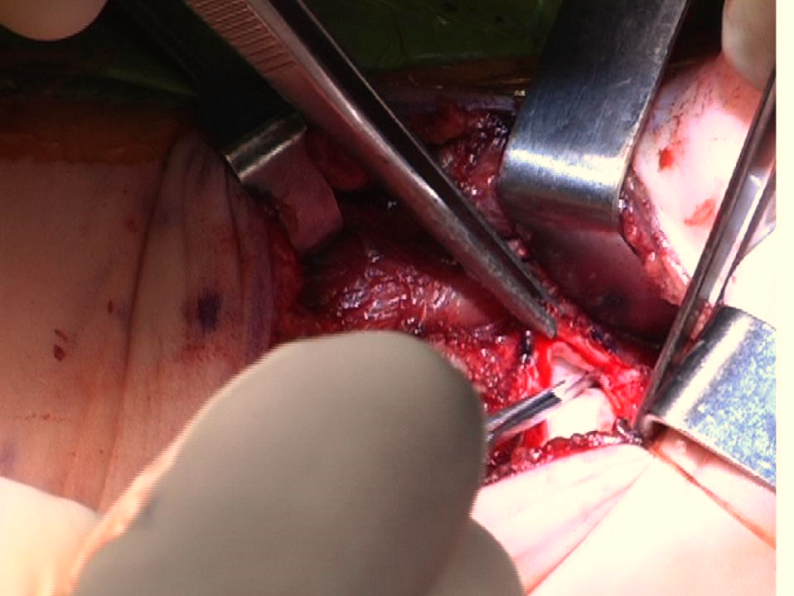

Slide 12
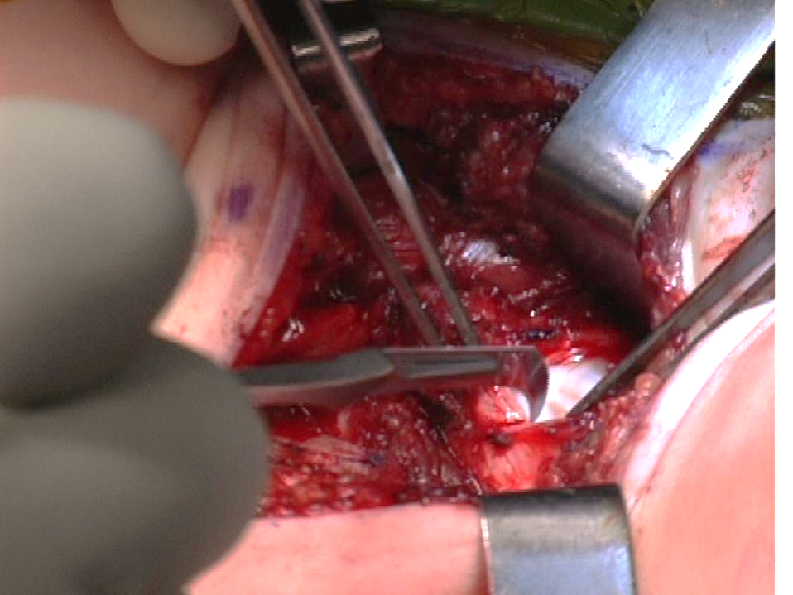
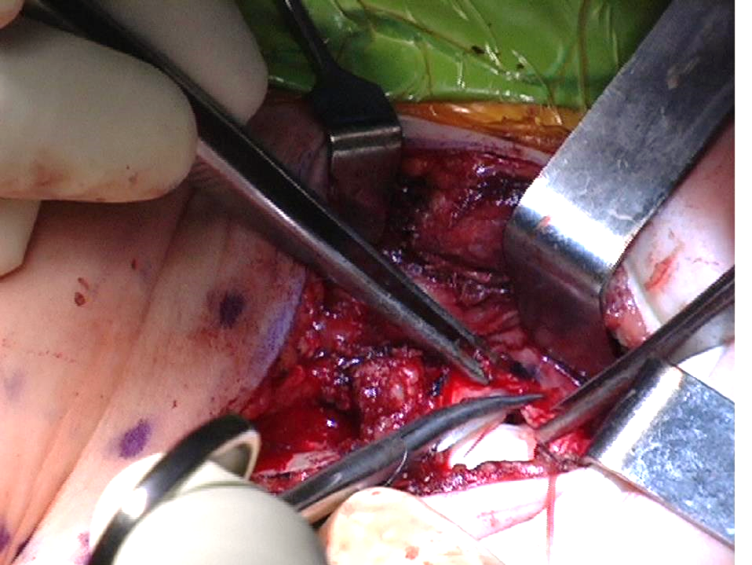
Lateral capsulotomy
Medial capsulotomy

Slide 13
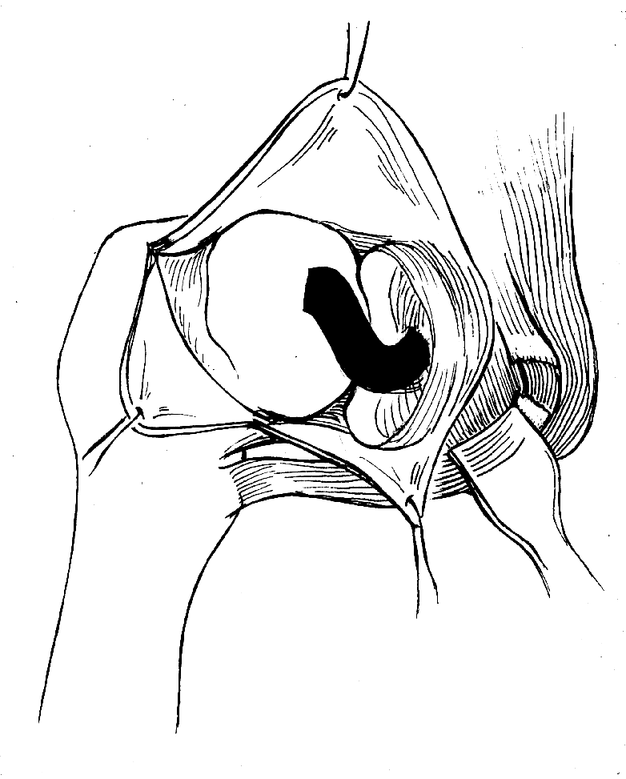
Beware of critical arterial blood supply
Capsulotomy

Slide 14
Lateral circumflex artery
Medial circumflex artery
Ogden JA. JBJS A 1974; 56:941.

Slide 15
Ogden JA. JBJS A 1974; 56:941.

Slide 16
Ganz R. JBJS B 2000
Ogden JA. JBJS A 1974; 56:941.

Slide 17
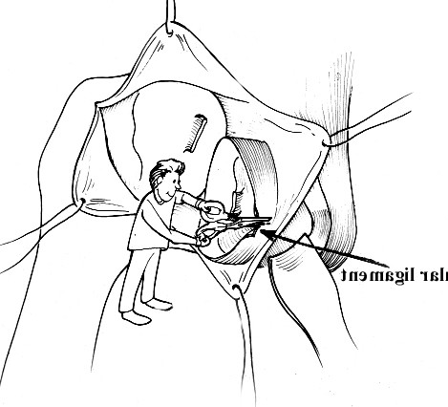
Excise
Transverse acetab. lig
Excise ligamentum teres
Open capsule medially & cut transverse ligament

Slide 18
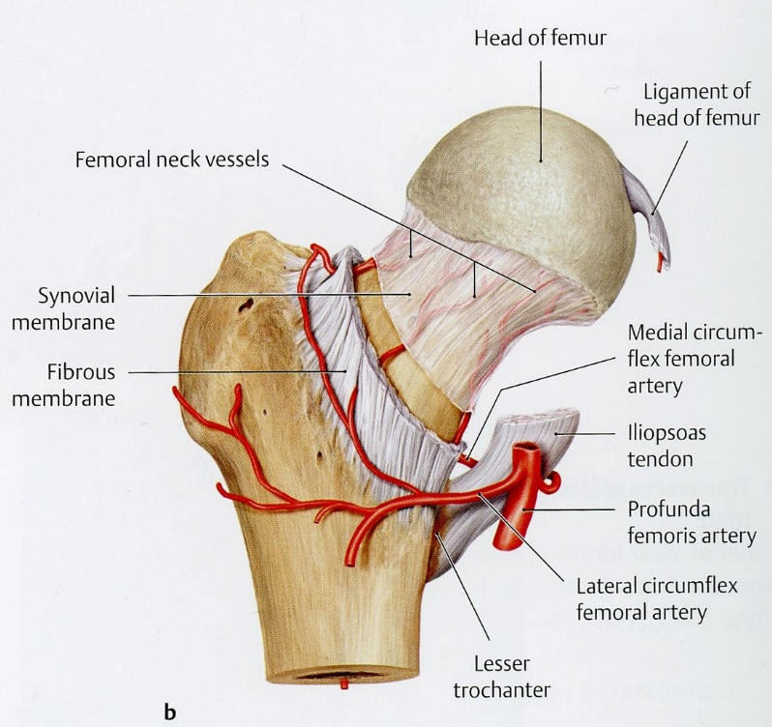
Transverse acetab. lig
Open capsule medially & cut transverse ligament

Slide 19
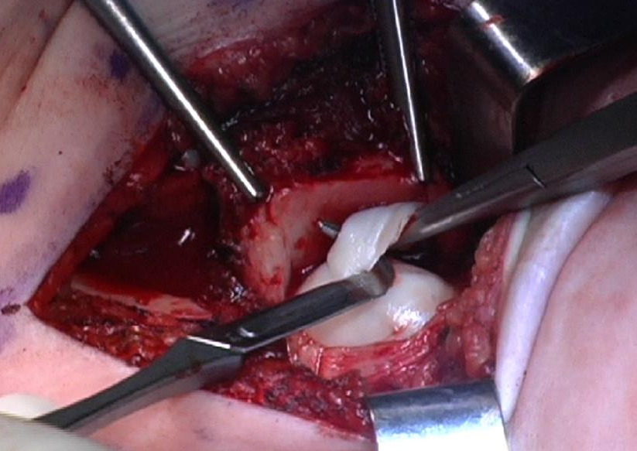
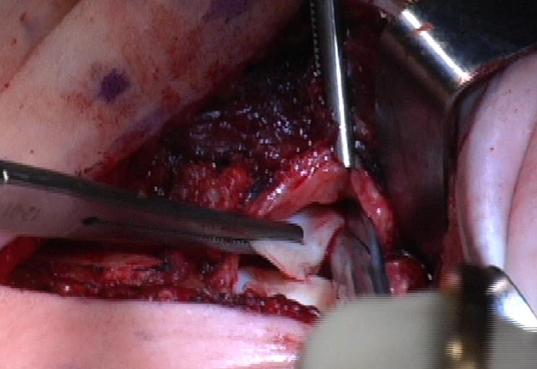
Notes:
Beachey, Janelle

Slide 20
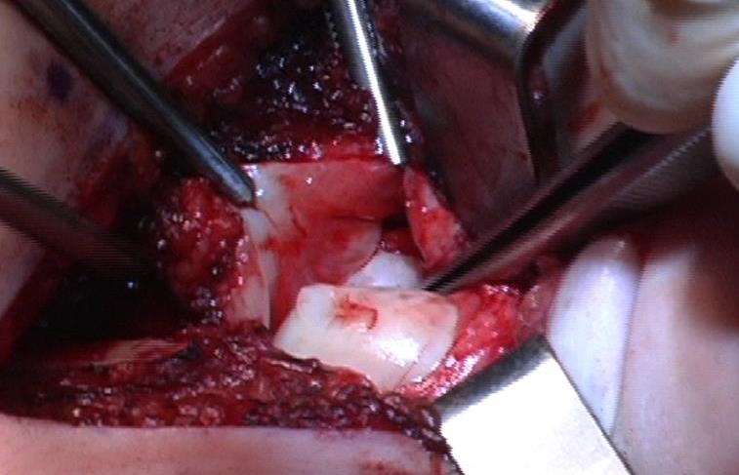
Capsule
Labrum
True acetabulum
False acetabulum
Head

Slide 21
Medial Capsule

Slide 23
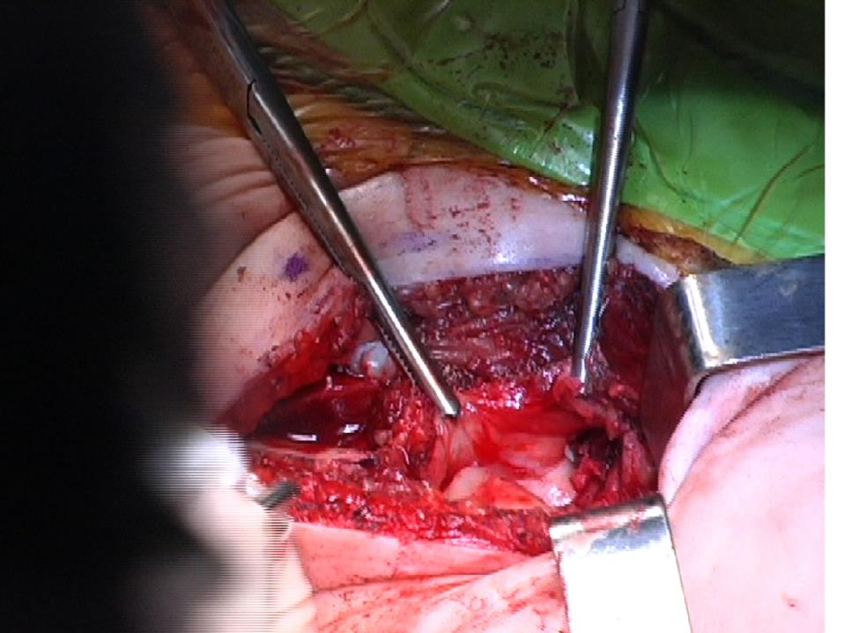
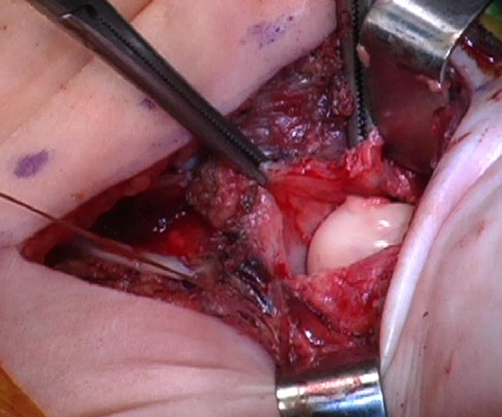
Dislocated
Reducing
Reduced

Slide 24
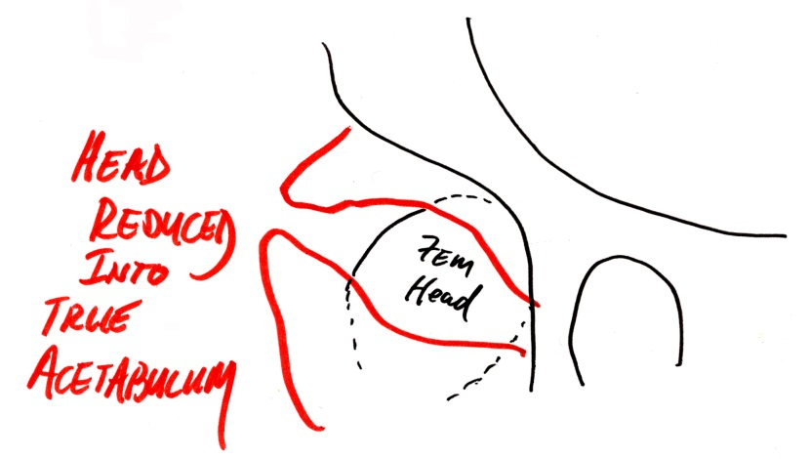
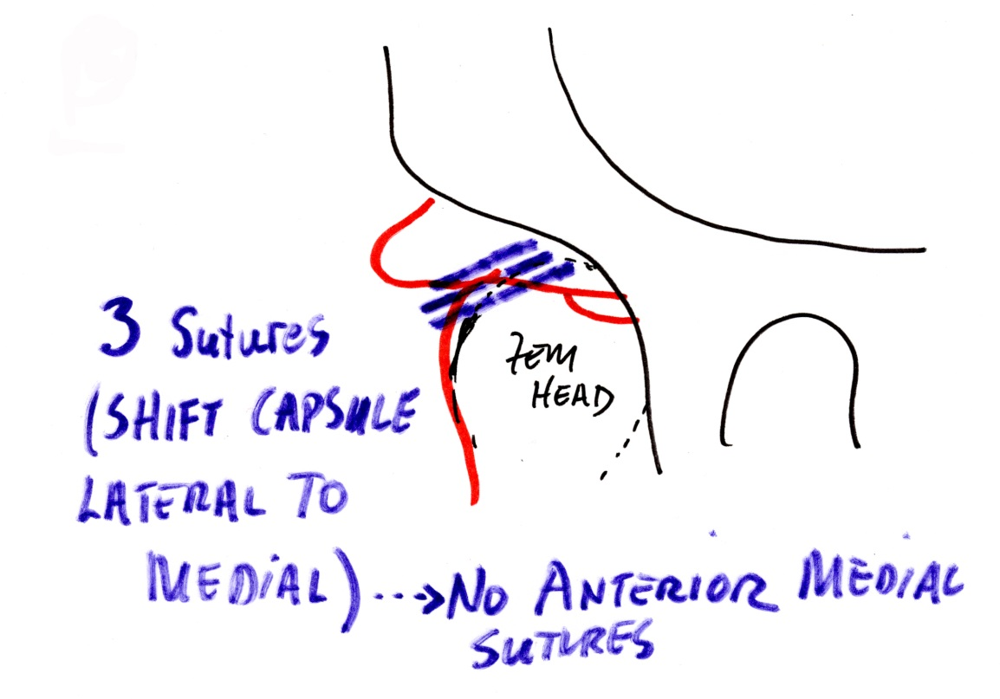

Slide 25
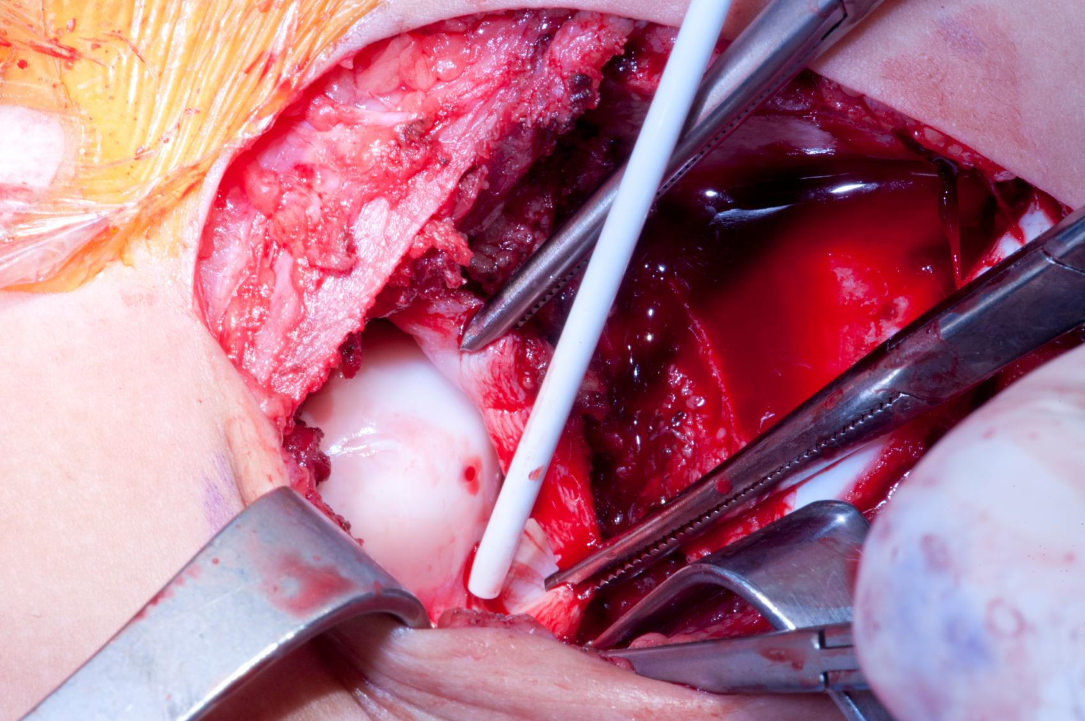
Your closure stitch is very close to the terminal branch of the medical circumflex
Notes:
Pena, Sade

Slide 26
Close carefully

Slide 27
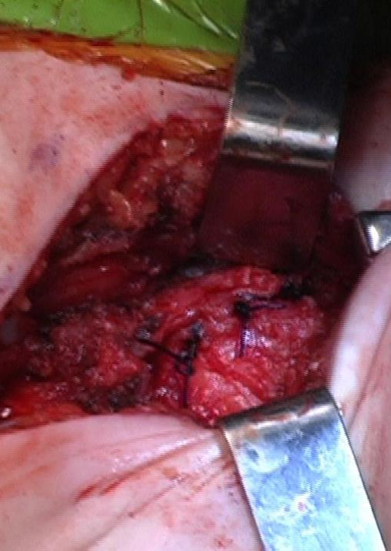

Slide 28
Most Medial capsule should open after closure
Femoral nerve
Iliopsoas tendon
Medial capsule pre-reduction is contracted

Slide 29
Failing to Reduce
Hip still laterally dislocated . . . Why??

Slide 30
Failure occurred because medial capsule not opened
Osteotomies are not a substitute for a poorly performed open reduction

Slide 31
Must clearly expose anterior & medial capsule
Femoral nerve
Iliopsoas tendon
Tight psoas, medial capsule contracted

Slide 32
obtaining lateral, anterior & MEDIAL capsule exposure prior to capsulotomy

Slide 33
Transverse acetab. lig
Open capsule medially & cut transverse ligament

Slide 34
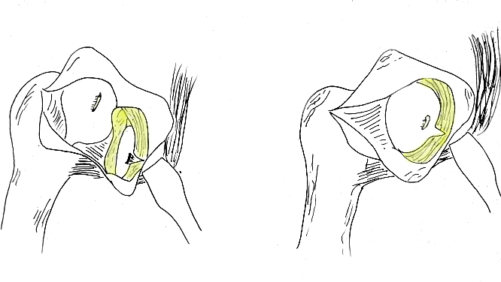
• Attempt reducing fem head medially into true acetab
True acetab
False acetab
• Reducible (too tight?) . . . . How stable?

Slide 35
Post re-do R hip and now L open reduction

Slide 36
Obrigado
--------------
Thank you

