Slide 1
5th Semi Annual POSNA/SLAOTI/EPOS
(Tri Continental) Pediatric Orthopedic Surgery Symposium
Sao Paulo, Brazil
October 11-14, 2017
Slipped Capital Femoral Epiphysis
Pathoanatomy/Classification/Residual
Problems
Perry L. Schoenecker, M.D.
St. Louis Shriners, St. Louis Children’s & Barnes Hospitals, Washington University School of Medicine, Department of Orthopaedic Surgery, St. Louis, Missouri, USA

Slide 2
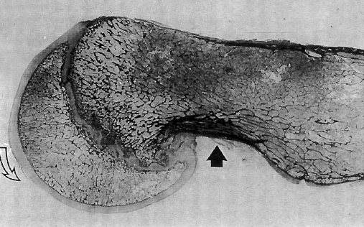
Slipped Capital Femoral Epiphysis
Pathoanatomy/Classification/Residual
Problems
Perry L. Schoenecker, M.D.,
No Conflicts, No Disclosures

Slide 3
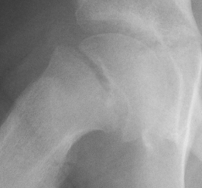
How do We Classify Slips?
(Duration/Severity/Stability)
Duration of symptoms:
Acute: < few wks; may be stable or unstable

Slide 4
How do We Classify Slips?
(Duration/Severity/Stability)
Duration of symptoms:
Chronic: > few wks; stable (most common presentation)

Slide 5
How do We Classify Slips?
(Duration/Severity/Stability)
Duration of symptoms:
Acute on chronic: recent worsening of long- standing slip; implies increasing instability

Slide 6
SCFE - - - Clinical Presentation
Courtesy: Dr. E. Abraham University of Illinois – Chicago

Slide 7
SCFE - - - Residual Deformity
Courtesy: Dr. E. Abraham University of Illinois – Chicago
• Clinical Presentation:w/ flex impingement of metaph beak against acetab blocks flex. & forces hip in to ER
SCFE

Slide 8
Classification --- Severity
Epiphyseal
-shaft angle
or slip angle
50°

Slide 9
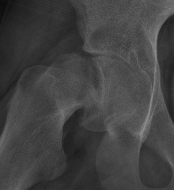
Slip Angle
50°
27°
Mild <30°
Moderate 30-60°
70°
Severe > 60

Slide 10
Assess severity also by Residual Metaphyseal Translational Deformity (bump)→

Slide 11
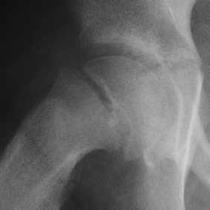
“Mild”
“Severe”
With greater slip angle
→ larger problematic bump

Slide 12
Smaller “bump” gets into the acetabulum = inclusion bump
→ labral chondral injury
M Luenig et. al. Acta 2000

Slide 13
Bump remodeling may ↑ motion but
w/ ↑ impingement
Notes:
Curtis, Haylee

Slide 14
Large bumps impact against the edge of the acetabulum → labral contusion
Notes:
Stultz, Nat

Slide 15
SCFE Classification (Duration/Severity/Stability)
What is a Stable/Unstable Slip?
Stable Slips: Able to walk – from minimal findings & “pre-slip” on x-ray to pronounced limp of the chronically slipped hip w/ severe deformity
Unstable Slips: Inability to walk- hip “gave way”; hip exam very uncomfortable; acute displacement of epiphysis

Slide 16
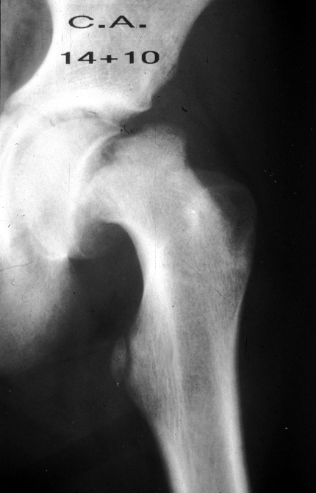
“Tripped” – now unable to walk even w/ crutches – physeal unstable slip
Pt walks into office for exam & is limping – physeal stable slip

Slide 17
Given an active patient, w/ a stable but impinged hip → can become so painful → refuses to walk
Stable slip

Slide 18
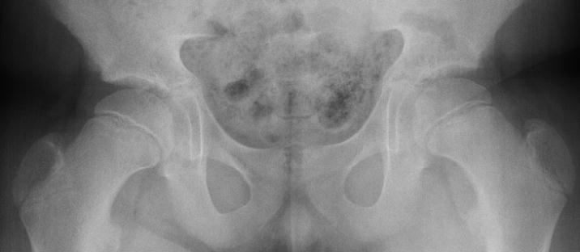
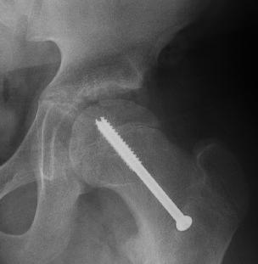
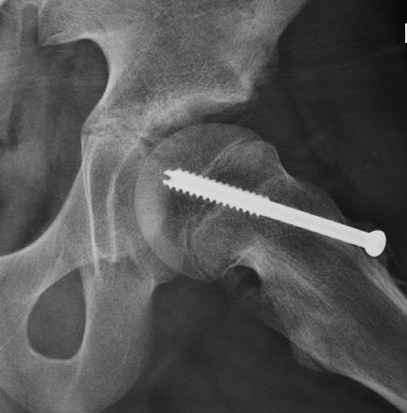
Case Example: 11+6 , bilat hip pain
On f/u 9mos post stabilization, recurrent pain L hip
Frog Lat
To tx or not?
AP
Notes:
Schmucker, Victor

Slide 19
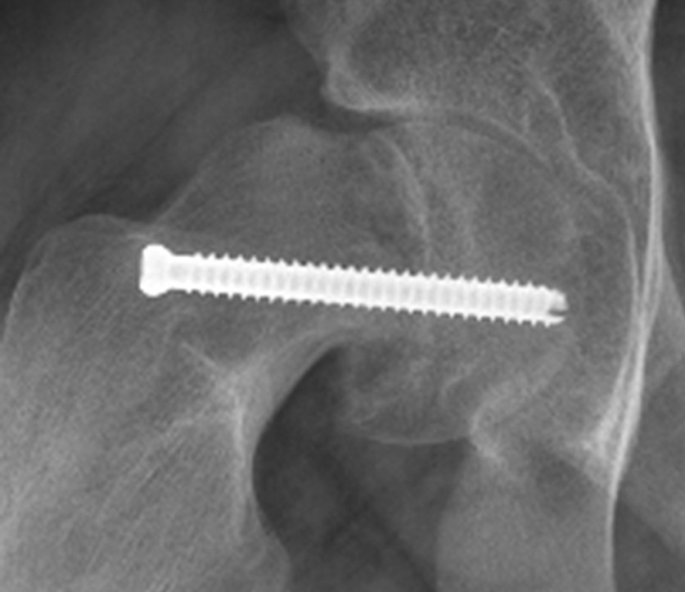
4 months post stabilization w/ ER gait deformity flexion 60 w/ ext rot
Your Tx?
Notes:
Nathan Stultz OR 2-14-12

Slide 20
Post Slip Fixation
ER def & ROM L hip
75°
Tx Approach?
Notes:
Adam Salman

Slide 21
“Tripped” – now unable to walk even w/ crutches – physeal unstable slip
…Your Tx approach

Slide 23
Case Example: 11+6 , bilat hip pain
On f/u 9mos post stabilization, recurrent pain L hip
Frog Lat
To tx or not?
AP
Notes:
Schmucker, Victor

Slide 24
Hip Extension
Hip Flexion (painful bumping)
Pathologic Inclusion Bump w/o gait deformity
M Luenig et. al. Acta 2000
Notes:
Schmucker, Victor

Slide 25
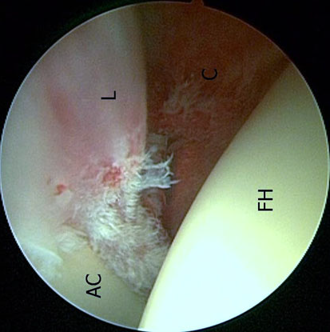
L=labrum
C=capsule
“Painful impingement”
“Small” inclusion bump damages labral-chondral junction
AC=acetabulum
FH=fem head
M Luenig et. al. CORR 2010

Slide 26
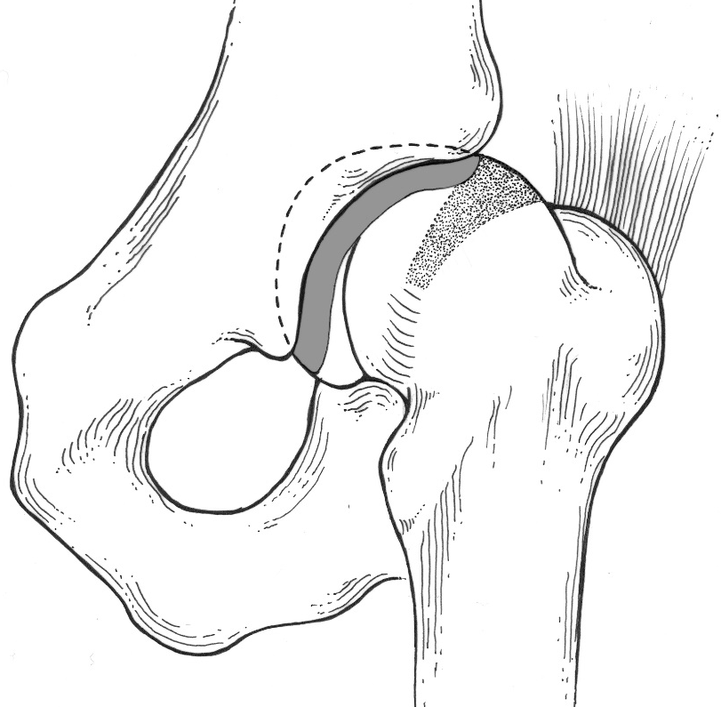
Post/lat vessels
PLS®
Anterior Arthrotomy & Osteochondroplasty (bumpectomy)
Pre
Post
Pain resolved
Notes:
Schmucker, Victor

Slide 27
F/u 4 mos post-op, ↑↑ hip pain
& toe out gait deformity
Anterior bump
Lateral bump
Frog-Lat
AP
Your Op Approach?
Notes:
Weller, Chyann

Slide 28
Frog-Lat
PLS®
Anterior Arthrotomy & Osteochondroplasty (bumpectomy)

Slide 29
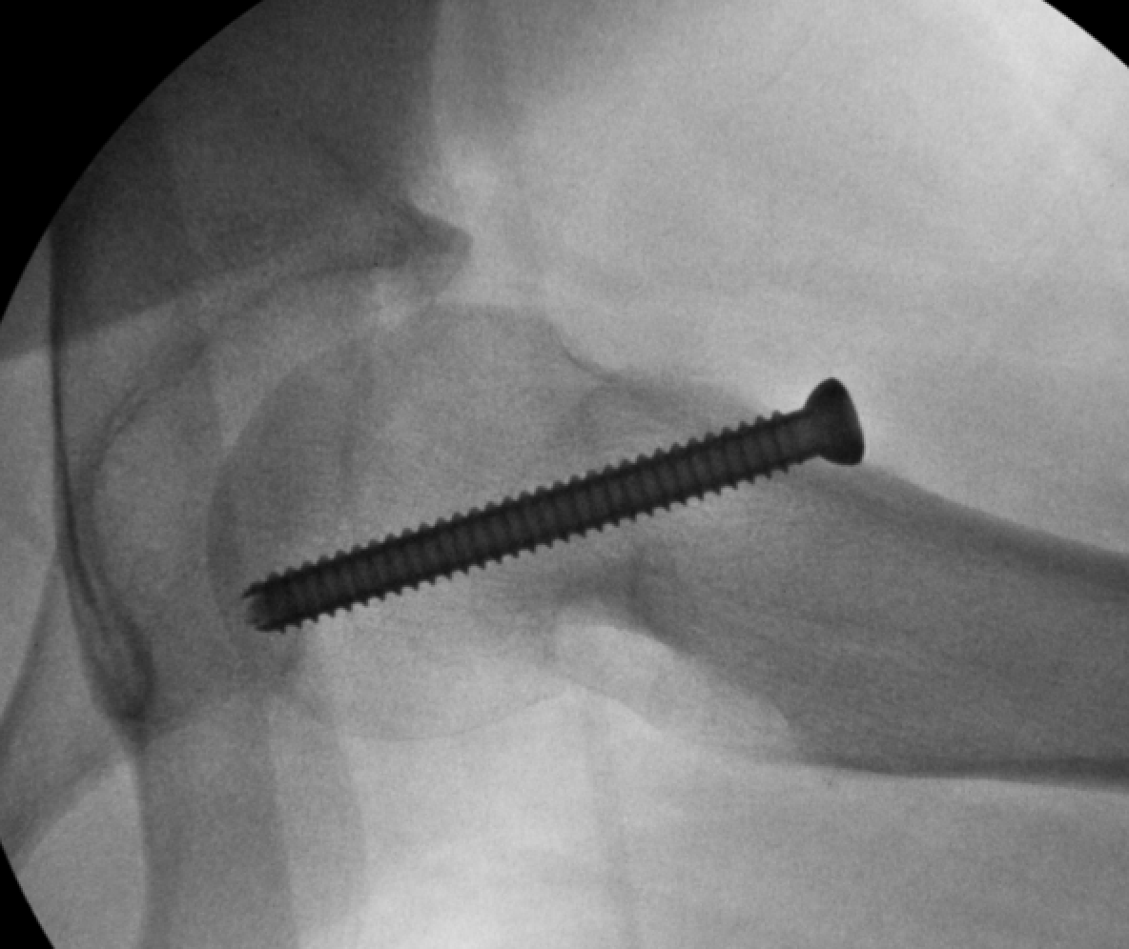
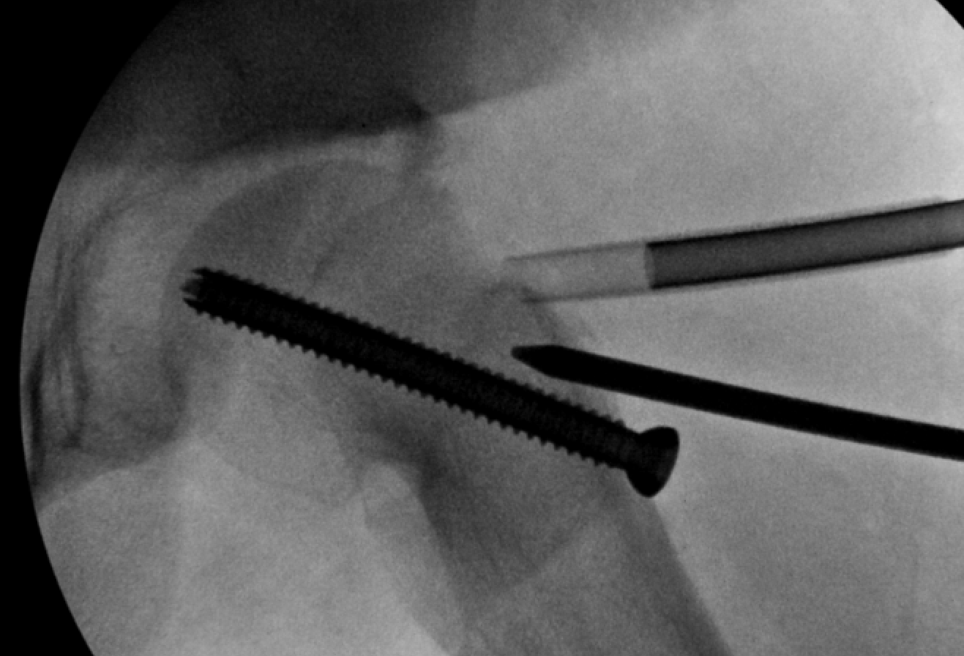
More & more bumpectomies now done with arthroscopy
Notes:
Madalyn hill

Slide 30
S/P flex/rot PFO
& osteochondroplasty
Pre
Lateral bump
Post
Osteotomy
AP
Notes:
Weller, chyann

Slide 31
& osteochondroplasty
S/P flex/rot PFO
Pre Anterior bump
Post
FrogLat
Notes:
Weller, chyann

Slide 32
“Tripped” – now unable to walk even w/ crutches – physeal unstable slip
…Your Tx approach

Slide 33
Epiphyseal Unstable (Slip)
Notes:
Before we discuss specifics of addressing these deformities, we must remember that the severe group is confounded by a much greater risk of developing avascular necrosis.

Slide 34
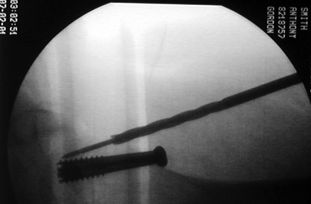
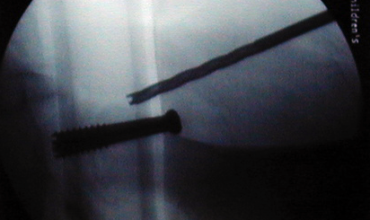
“Capsulotomy” post slip reduction
Guide wire placed into Femoral head
Drill through capsule for capsulotomy

Slide 35
Acute Unstable Slip
Gently reduce the instability & stabilize
Notes:
Brandi Morell

Slide 36
Anterior arthrotomy/gentle reduction (Parsch Technique)
Parsch K, et. al. 2009, JPO

Slide 37
Goal of Tx Unstable Slip
14y/o unstable slip
Notes:
Adam Salman

Slide 38
2 weeks Post Slip Fixation
ER def & ROM L hip
75°
Notes:
Adam Salman

Slide 39
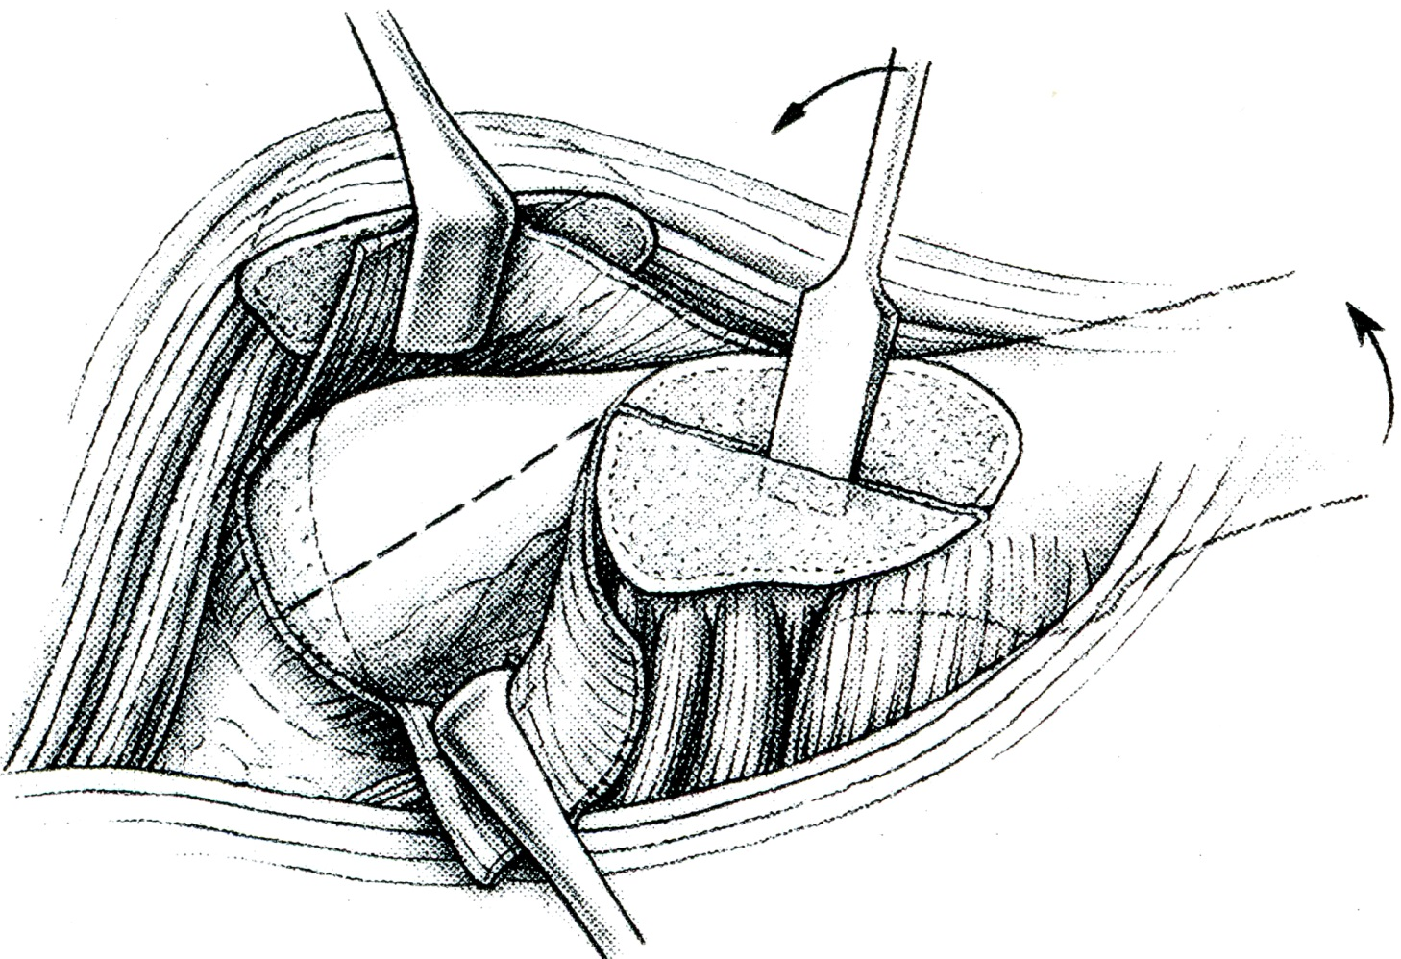
Modified Dunn Approach
Metaphysis
Base of trochanter
Head
Leunig, Slongo, Ganz. ICL 2008; 57:499-507

Slide 40
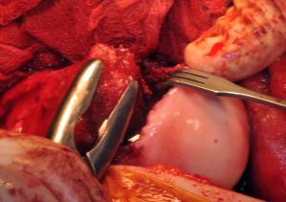
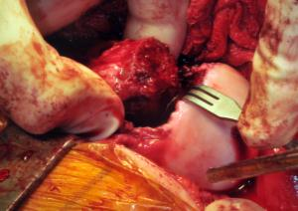
Shortening neck
Reducing
Stabilizing
Notes:
Salman, Adam

Slide 41
Dangerous Procedure
Do w/ someone experienced
Notes:
Salman, Adam

Slide 42
Bleeding from epiphysis
“Doppler” pulse detected at lateral retinaculum
Notes:
Salman, Adam

Slide 43
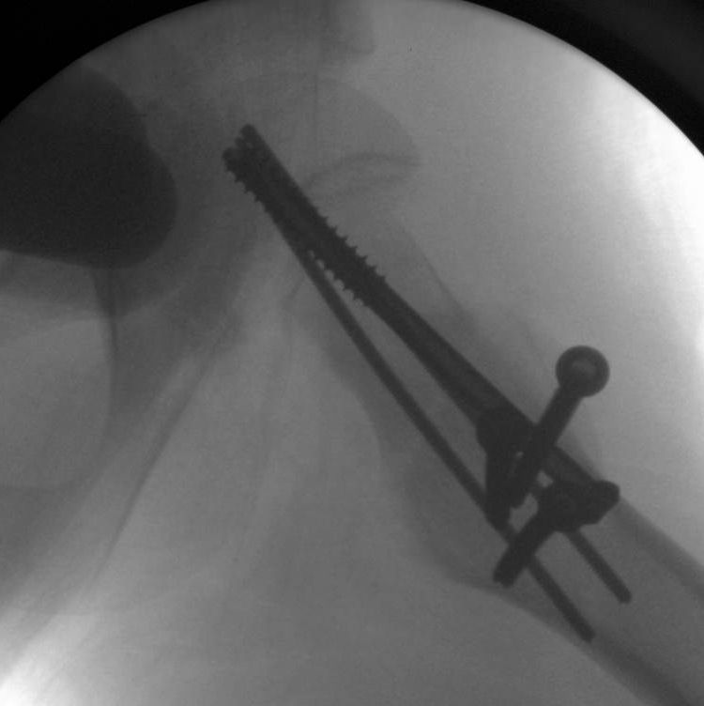
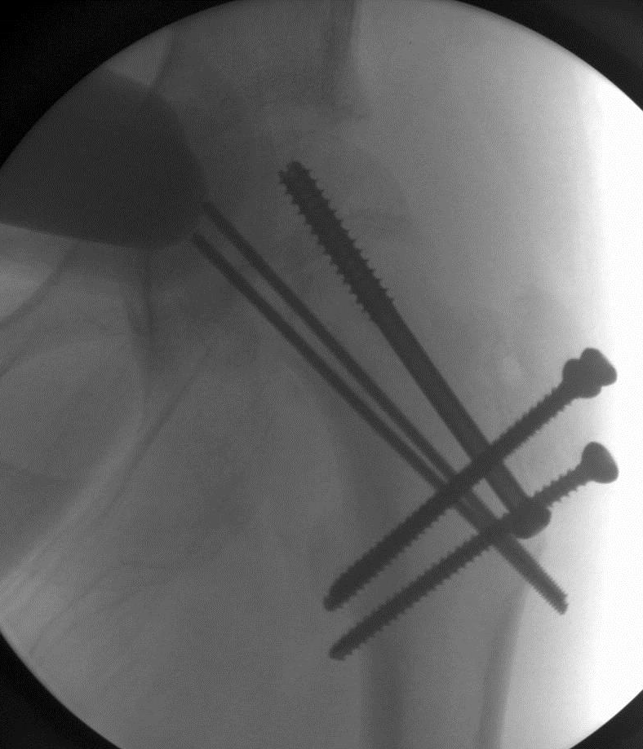
Modified Dunn Surgical Reduction
Notes:
Salman, Adam

Slide 44
AVN Rate after Tx Unstable SCFE (most current data)
Cld Red/Pinning (Loder JBJS ‘93) - - - - 35%
(very historical)
Cld Red/Pinning/Perc Capsulotomy - - - - <15%
(Gordon, St. Louis)
Ant Open Red/Pinning - - - - <5%
(Parsch, Germany)
SHD/Open Reduction - - - Variable; 5-65%!

Slide 45
With a better understanding of slip pathology, we are more likely to select (or not) an optimal surgical approach for our patients.

Slide 46
In turn, outcomes for our patients ought to be optimized.
Pre
Post
Pain resolved

Slide 47
Obrigado
--------------
Thank you

Slide 48
Goal of Tx Unstable Slip
Unstable Slip → As soon as possible → “positional reduction” & stabilization w/ the utmost care of epiphyseal blood flow

Slide 49
ER def & ↓ROM L hip
75°
An impaction bump is large & can’t get into acetabulum → severe labral contusion
M Luenig et. al. Acta 2000
Notes:
Adam Salman

